Slide 1

Data Analysis Project- Heart Disease Prediction

Slide 2
Aim of analysis
To predict whether a person will suffer from heart disease or not.
Since the prediction is to be made in a yes/no form, the dependent variable is categorical the given dataset can be analysed using logistic regression method or random forest method.

Slide 3
Understanding the dataset
The dataset was loaded in R using the read.csv command and viewed using the View command.
The dataset consists of 14 columns and data of 303 individuals. The variables can be explained as in the following table:-
Variable | Description
age | Age of the individual
sex | Gender of the individual (0 = female, 1 = male)
cp | Chest pain type (0 = typical angina, 1 = atypical angina, 2 = non-anginal pain, 3 = asymptomatic)

Slide 4
Variable | Description
trestbps | Resting blood pressure value of individual in mmHg
chol | Serum cholesterol level in mg/dl
fbs | Fasting blood sugar value of individual (compared with 120mg/dl; If fasting blood sugar > 120mg/dl, then 1, else 0)
restecg | Resting electrocardiographic results (0 = normal 1 = having ST-T wave abnormality 2 = left ventricular hyperthrophy)
thalach | Maximum heart rate achieved by an individual
exang | Exercise induced angina (1 = yes, 0 = no)
oldpeak | ST depression induced by exercise relative to rest
slope | Peak exercise ST segment (1 = upsloping, 2 = flat, 3 = downsloping)
ca | Number of major vessels
thal | Thalassemia (1 = normal, 2 = fixed defect, 3 = reversible defect)
target | Whether individual is suffering from heart attack or not (0 = absence, 1 = present)

Slide 5
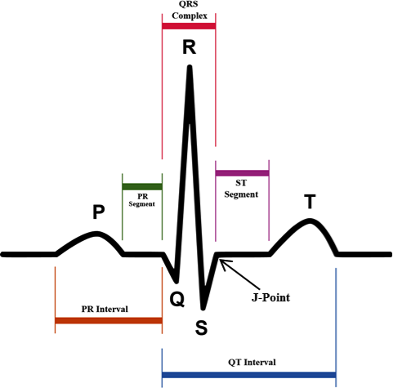
Explaination of terms:-
Clinical classification of chest pain (adapted from Braunwald et al (9))
Typical angina (definite) :
Substernal (below or behind the sternum) chest discomfort with a characteristic quality and duration that is
Provoked by exertion or emotional stress
Relieved by rest or nitroglycerine (medicine for heart attack)
Atypical angina (probable) : Meets two of the above characteristics.
Non – anginal pain : Meets one or none of the above characteristics.
Serum Cholesterol level : Measurement of the amount of high
and low-density lipoprotein cholesterol (HDL and LDL) and the amount
of triglycerides in a person's blood.
ST-T wave abnormalities in resting ecg : see diagram

Slide 6
Cleaning the dataset
The first step towards analysing the data is ensuring that it is usable. This can be done by classifying the columns into required data types, creating any required variables, checking for NA values and omitting or substituting them, removing outliers, etc.
This is one of the most important steps and must be completed before model-making to generate an accurate model

Slide 7
Changes made to variables
The classes of the following variables are converted into factors to accurately define their content-
sex
cp
Fbs
restecg
exang
slope
ca
thal
target

Slide 8
Other changes to data
Variable names are changed for better understanding
A new variable named ‘age_Category’ is created for categorising the age for better understanding of data and easier analysis
NA values are checked. No NA value present in data.

Slide 9
Why do we need to perform exploratory data analysis?
Exploratory data analysis(EDA) helps us to:
Get an overall view of the data
Focus on describing our sample
Identify unusual cases and extreme values
Identify obvious errors
Steps Involved are:
Approaching the data and finding which attributes are numeric and categorical
Finding missing(NA) values and taking appropriate action
Checking for correlation between variables, normality and other statistical quantities
Visualisations of the data using histograms, bar plots etc.
Finding outliers from such plots

Slide 10
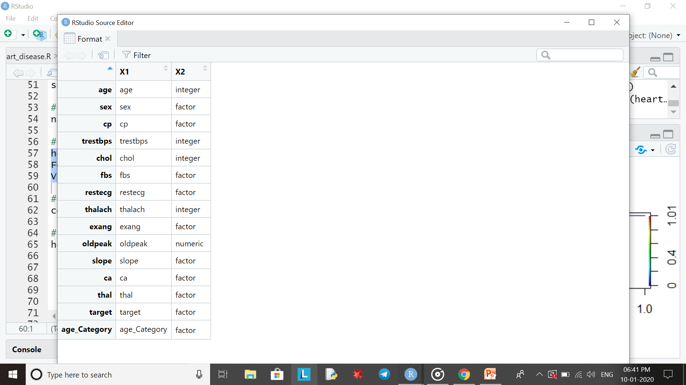
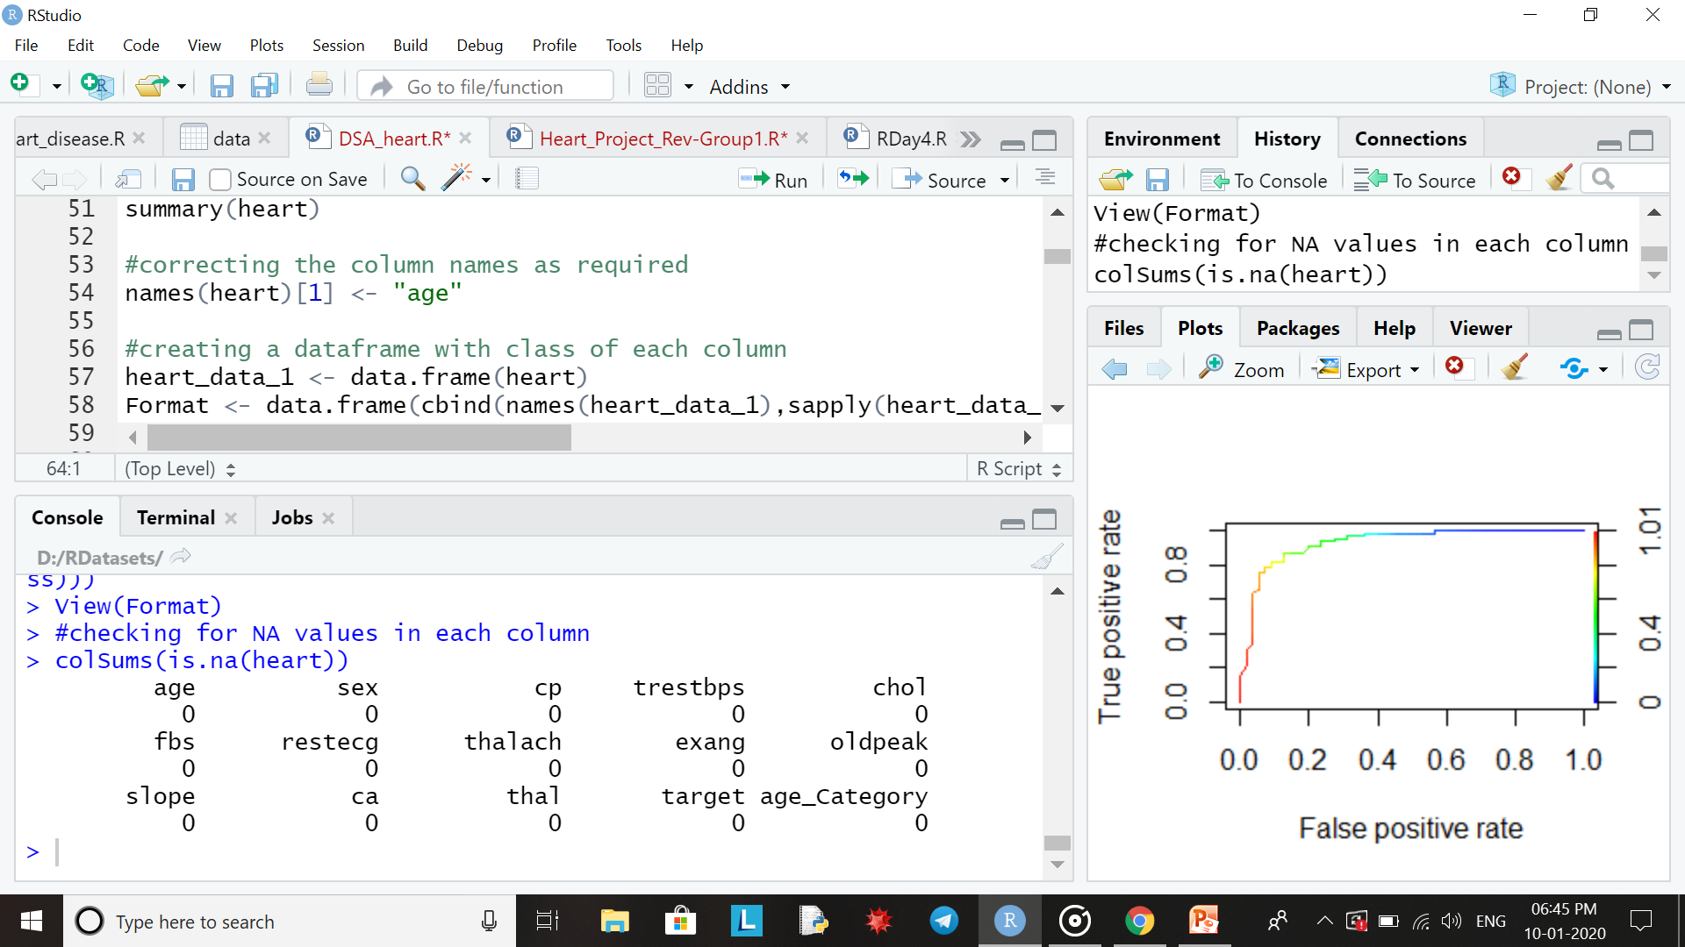
Approaching the dataset
In the “Heart diseases “ dataset:
Step 1:
All the variables except ‘oldpeak’ were of int type, so we sorted out the variables that should be of numeric type and those which should be of factor type according to our understanding of the data. Therefore the data types were changed as given alongside:
Step 2:
Finding missing (NA) values. This data set had no missing values as seen below. Since there were no NA values no action was taken.

Slide 11
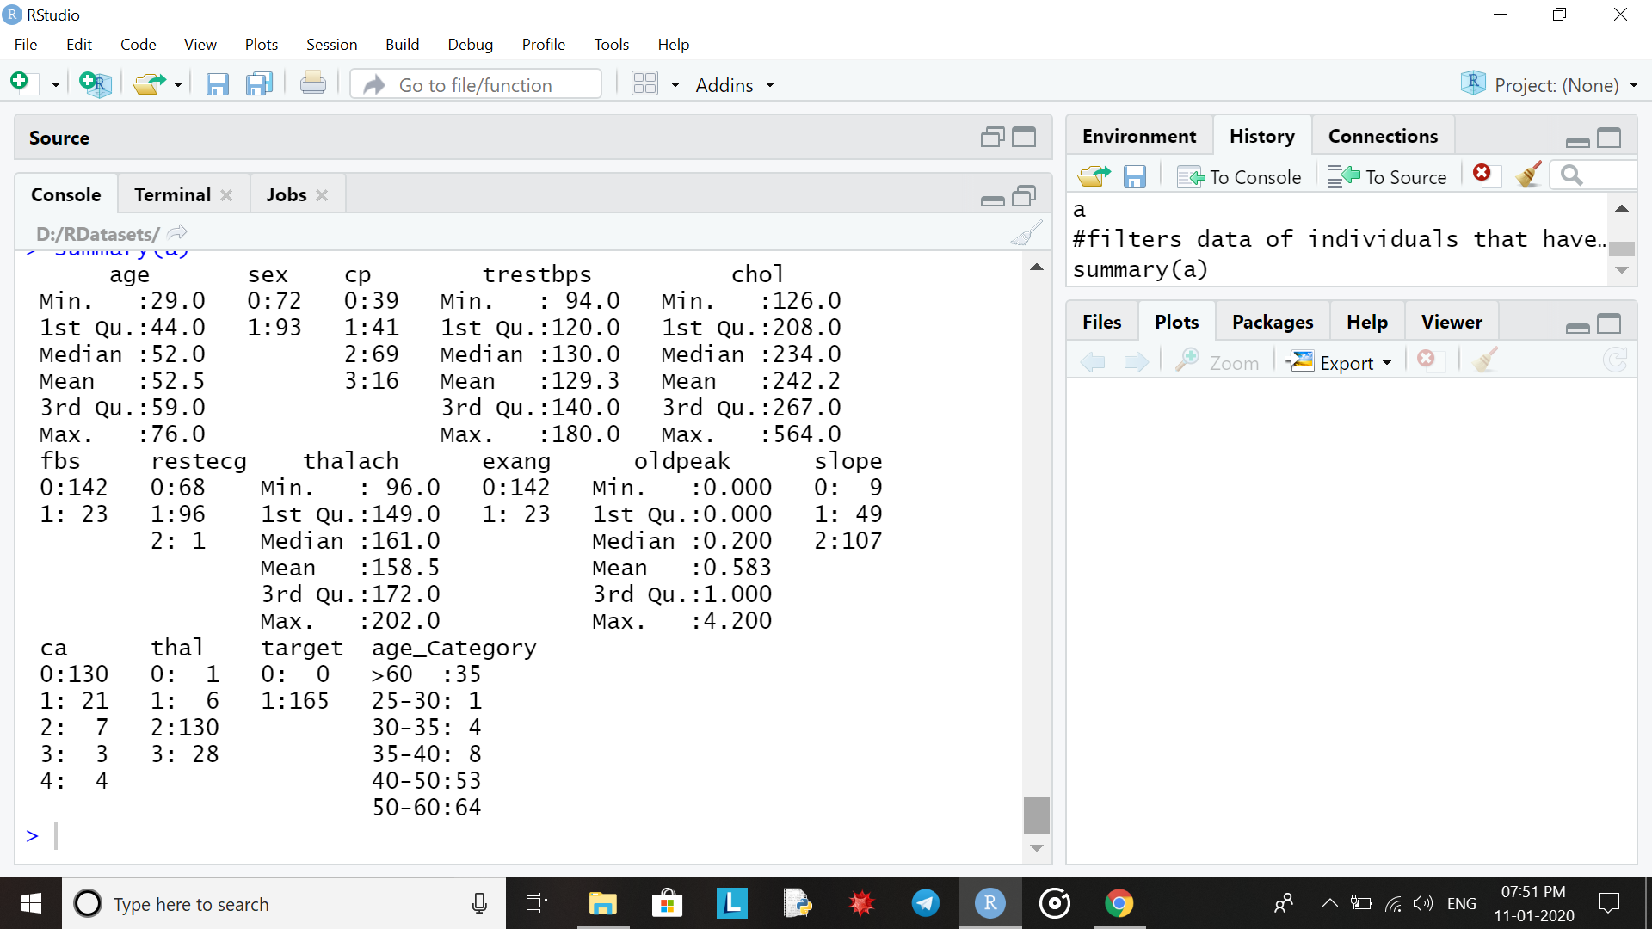
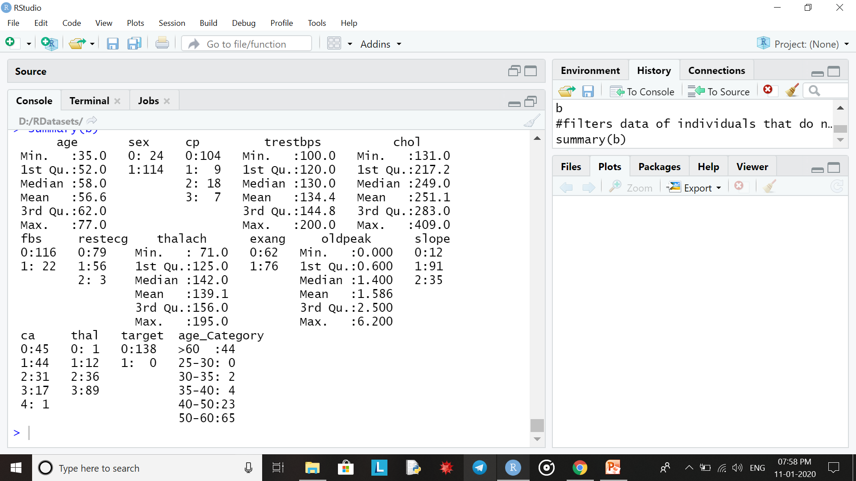
Statistical summary gives us the mean, median, 1st and 3rd quartile and minimum and maximum values of each column in the data set
Statistical summary of the data of people with heart diseases
Statistical summary of the data of people without heart diseases

Slide 12
Histograms
A histogram represents the frequencies of values of a variable bucketed into ranges.
Histogram is similar to bar chart but the difference is it groups the values into continuous ranges.
Each bar in histogram represents the height of the number of values present in that range.
We have plotted histograms for the variables age, chol, trestbps, thalach, oldpeak all of which are of integer or numeric type using the hist() function.
The next few slides contain the histograms of these attributes with frequency on the y-axis vs the attribute on the x-axis

Slide 13
Drawing insights
Divided the data equally on the basis of target.
Now we have a subset of data of individuals having heart disease and those not having heart disease.
Compared summaries of variables from each subset to draw insights.
Plotted histograms and ggplots for the subsets and compared the results to draw insights.

Slide 14
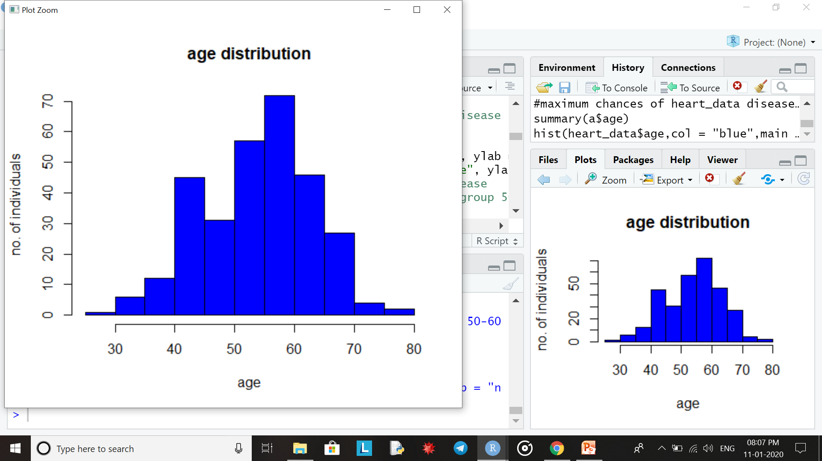
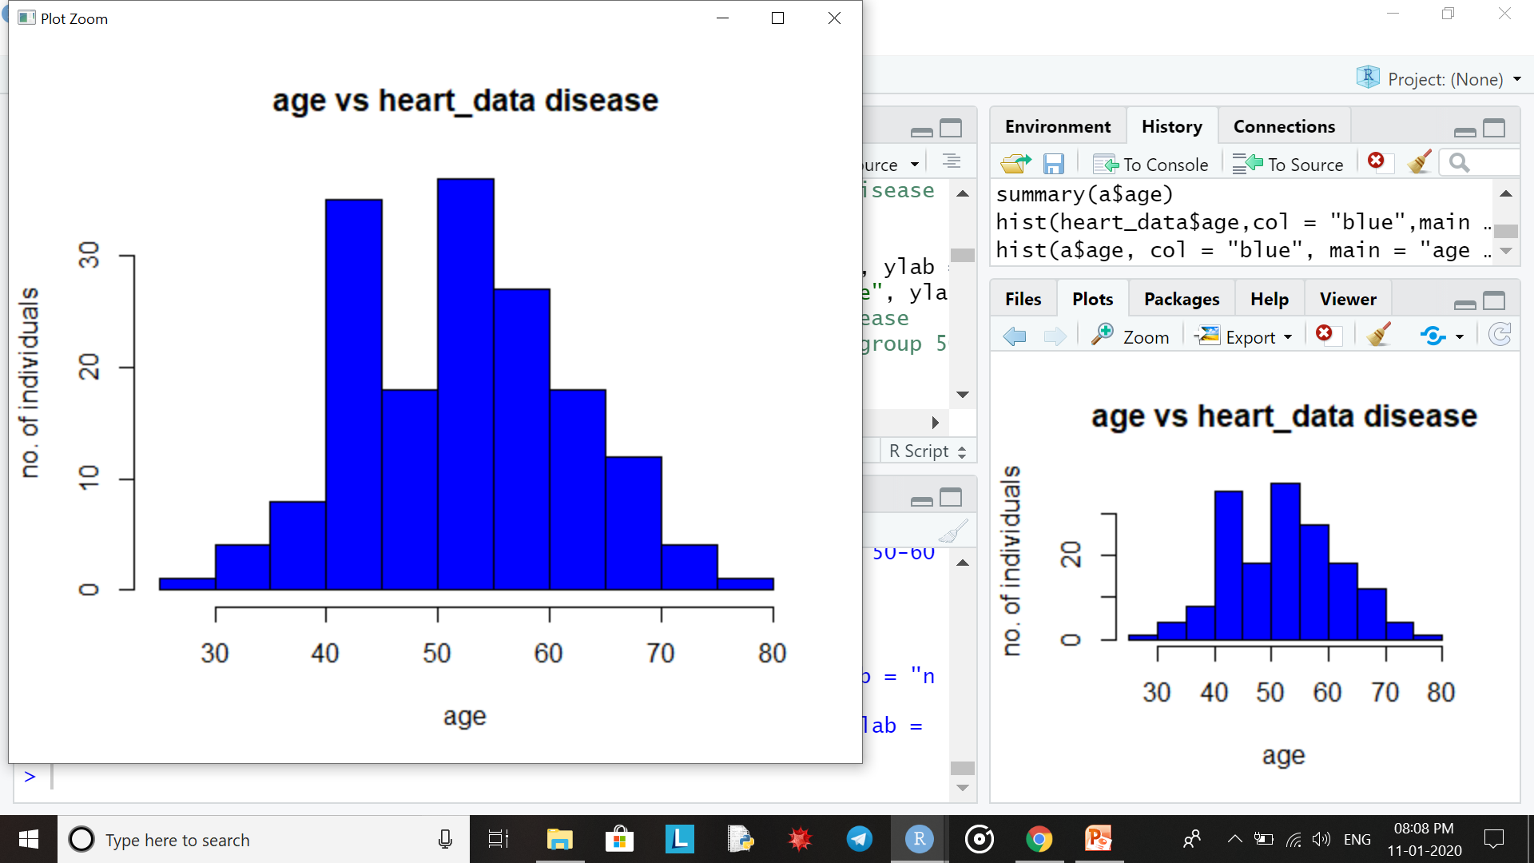
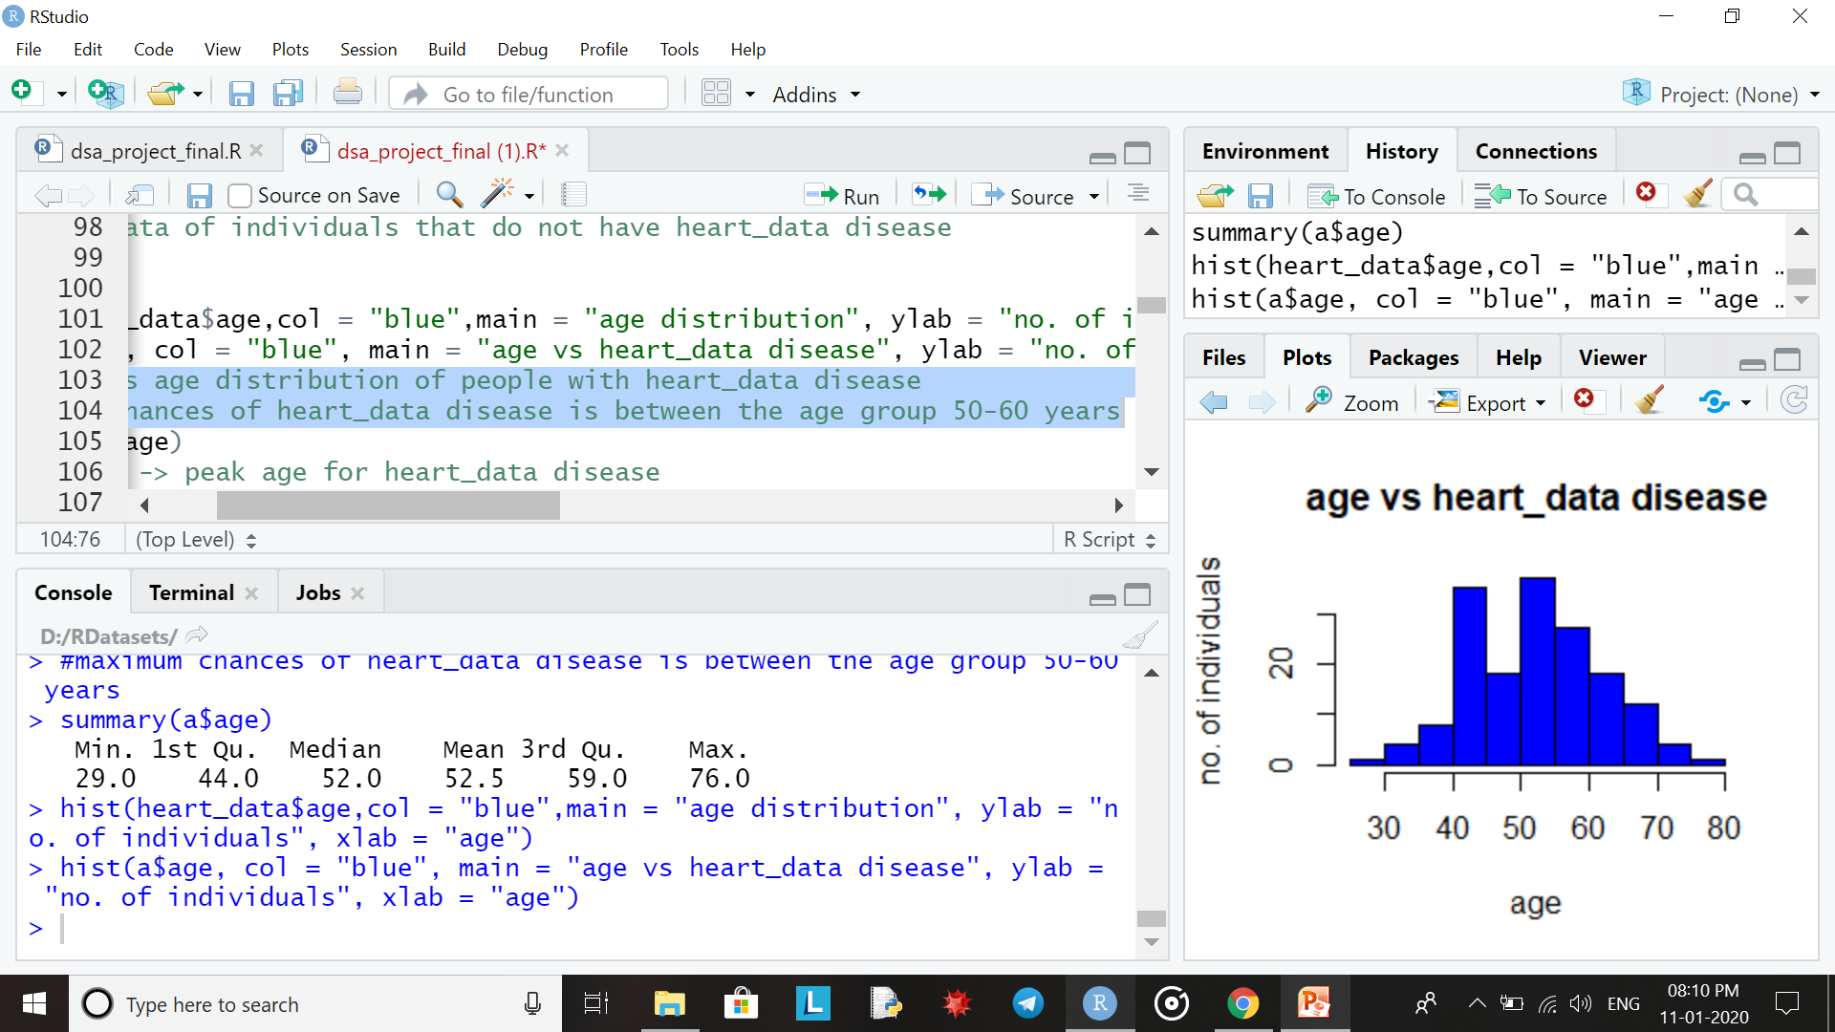
represents age distribution of people with heart disease
maximum chances of heart disease is between the age group 50-60 years
This shows that the peak age for heart disease is 53

Slide 15
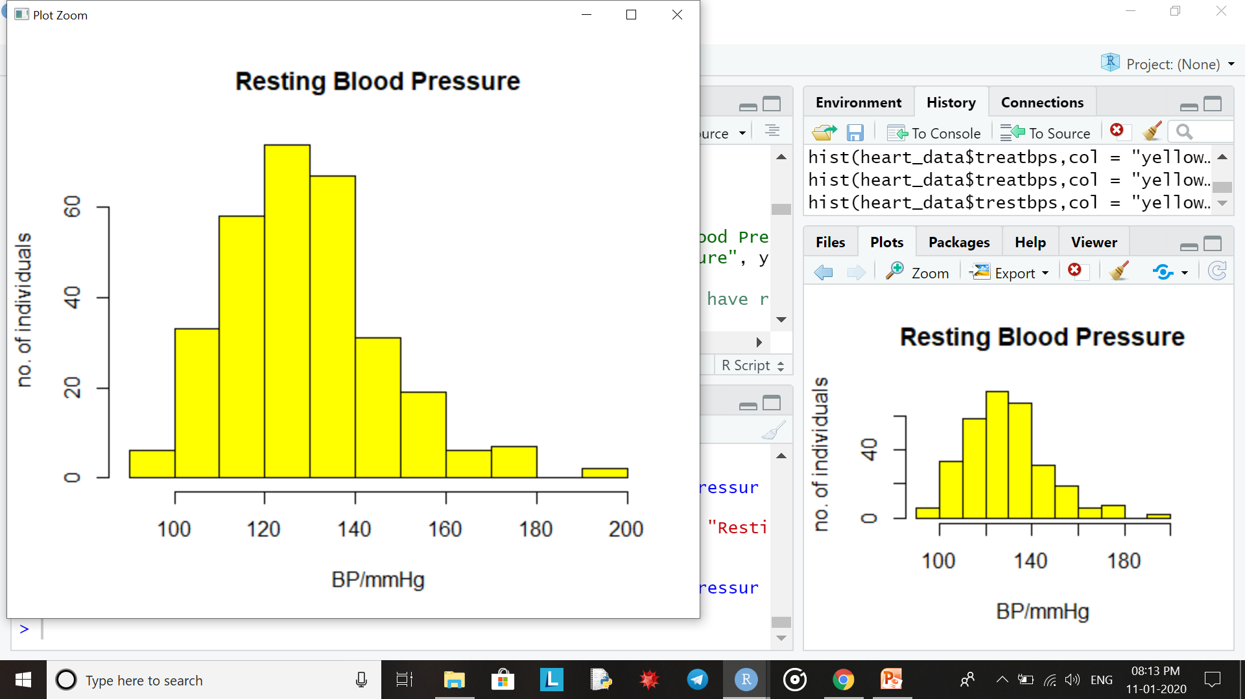
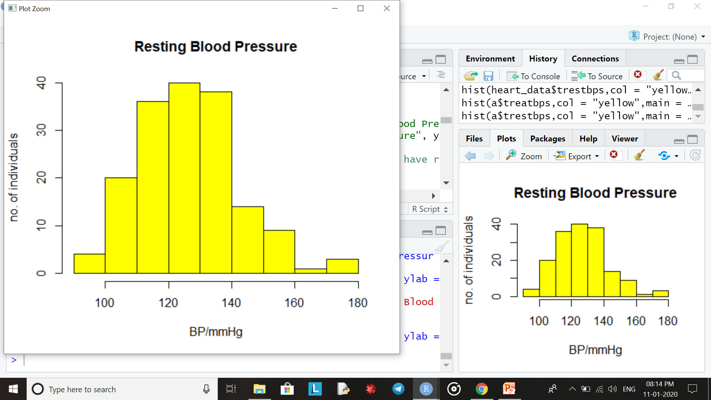
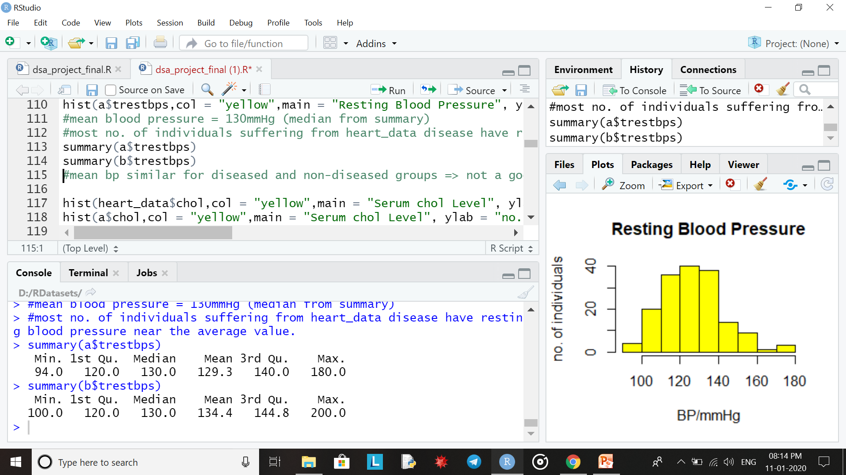
Entire data set
For individuals with heart disease
mean blood pressure = 130mmHg (median from summary)
most no. of individuals suffering from heart disease have resting blood pressure near the average value.
mean bp similar for diseased and non-diseased groups which means it’s not a good predictive feature

Slide 16
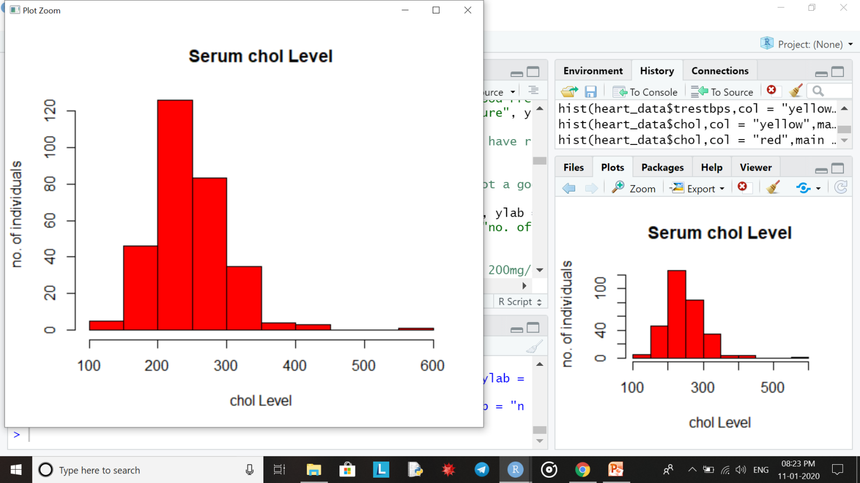
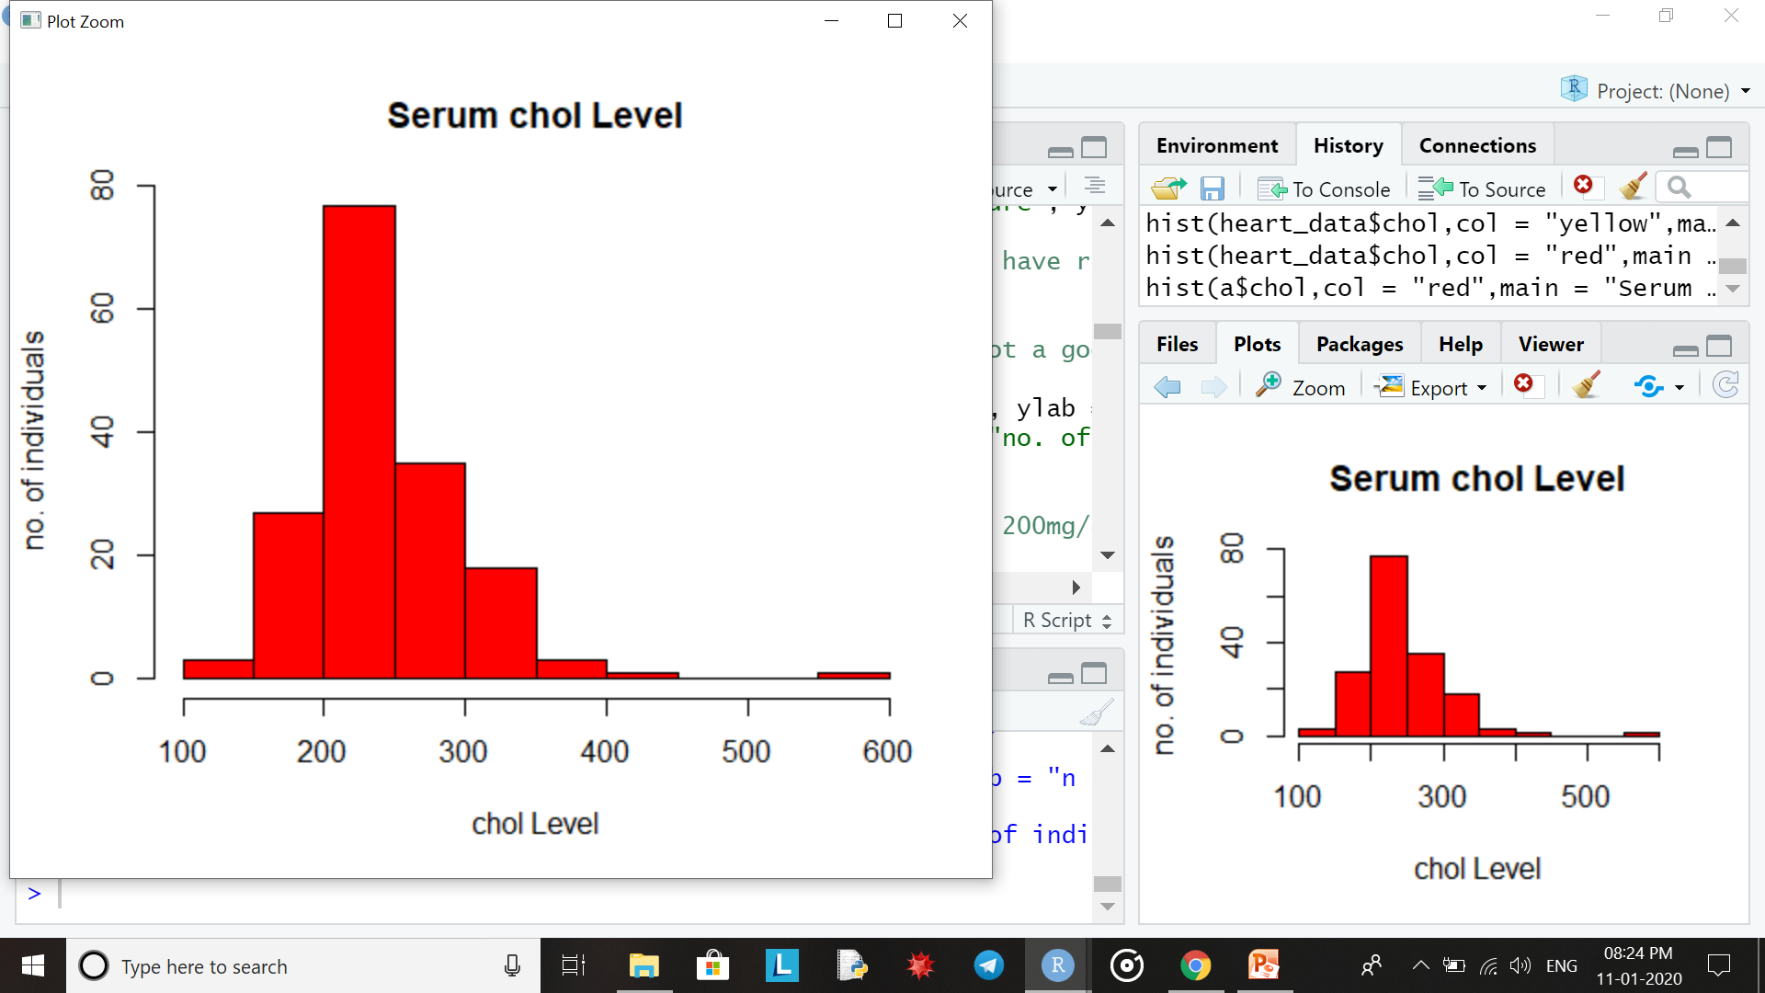
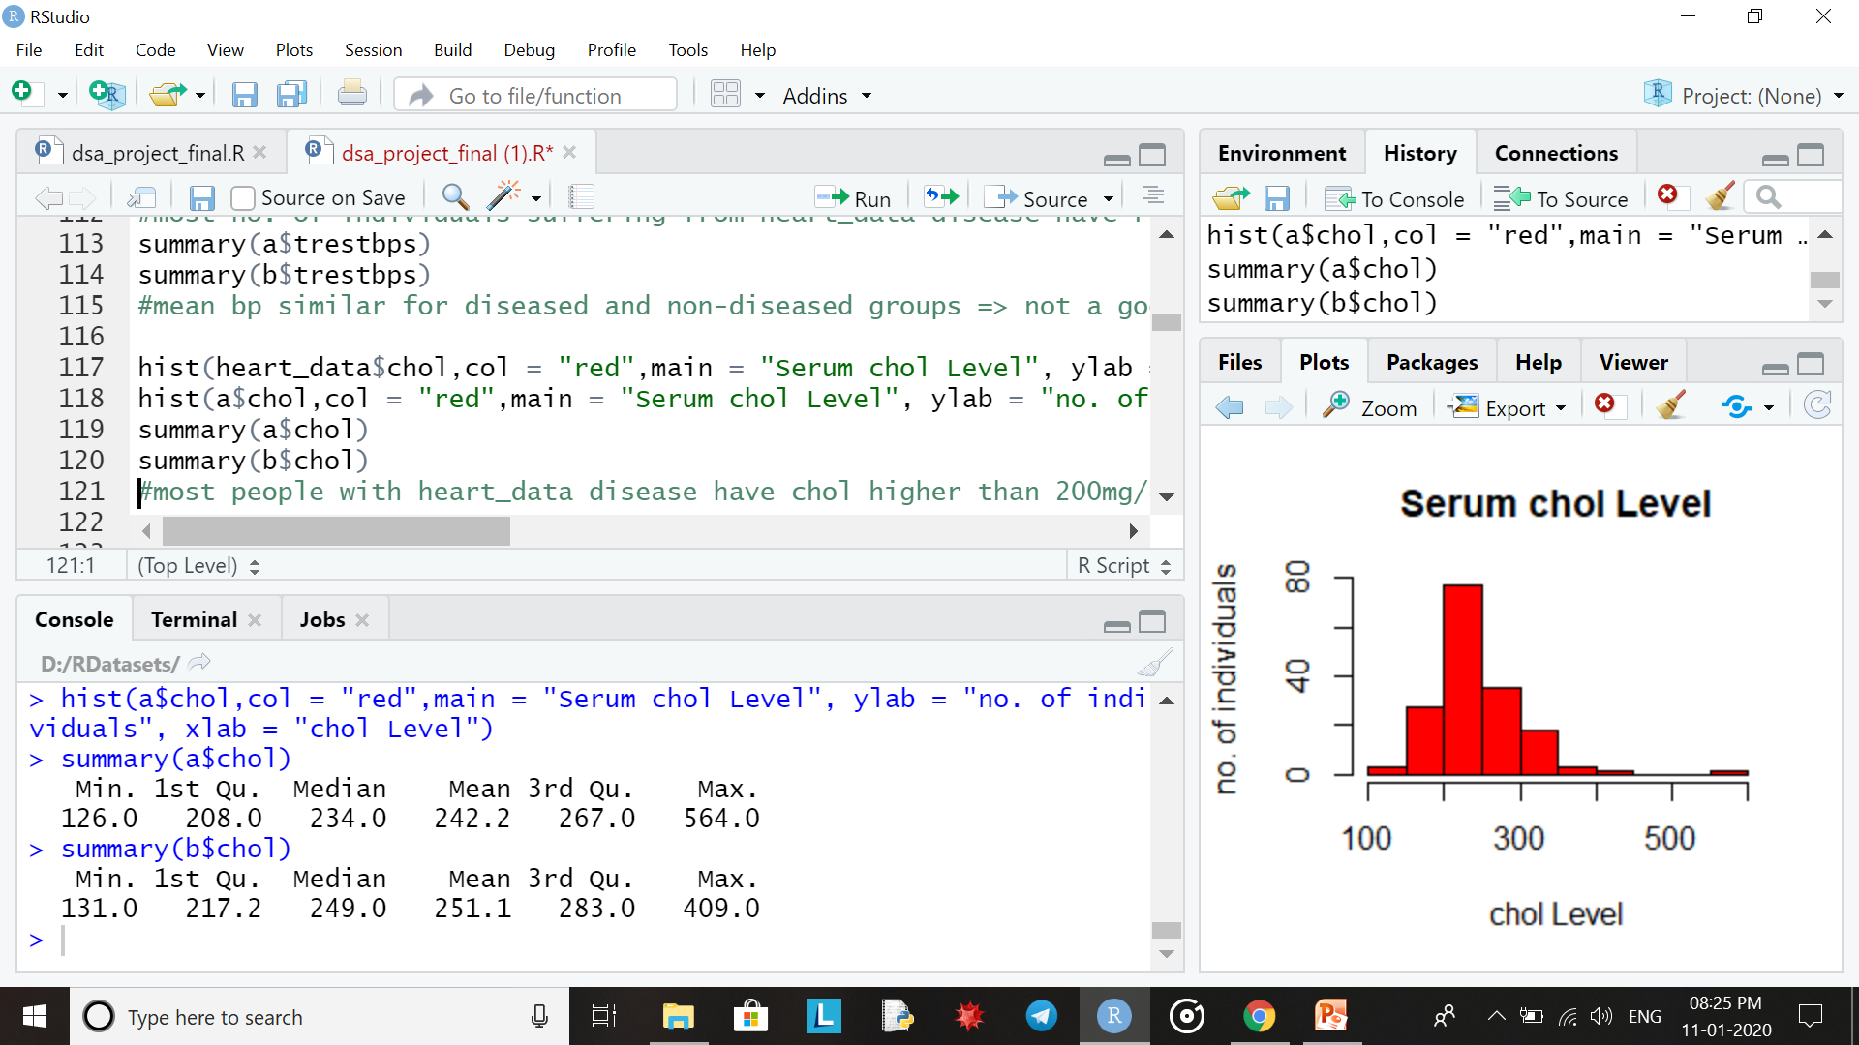
Entire data set
For individuals with heart disease
most people with heart disease have chol higher than 200mg/dL.

Slide 17
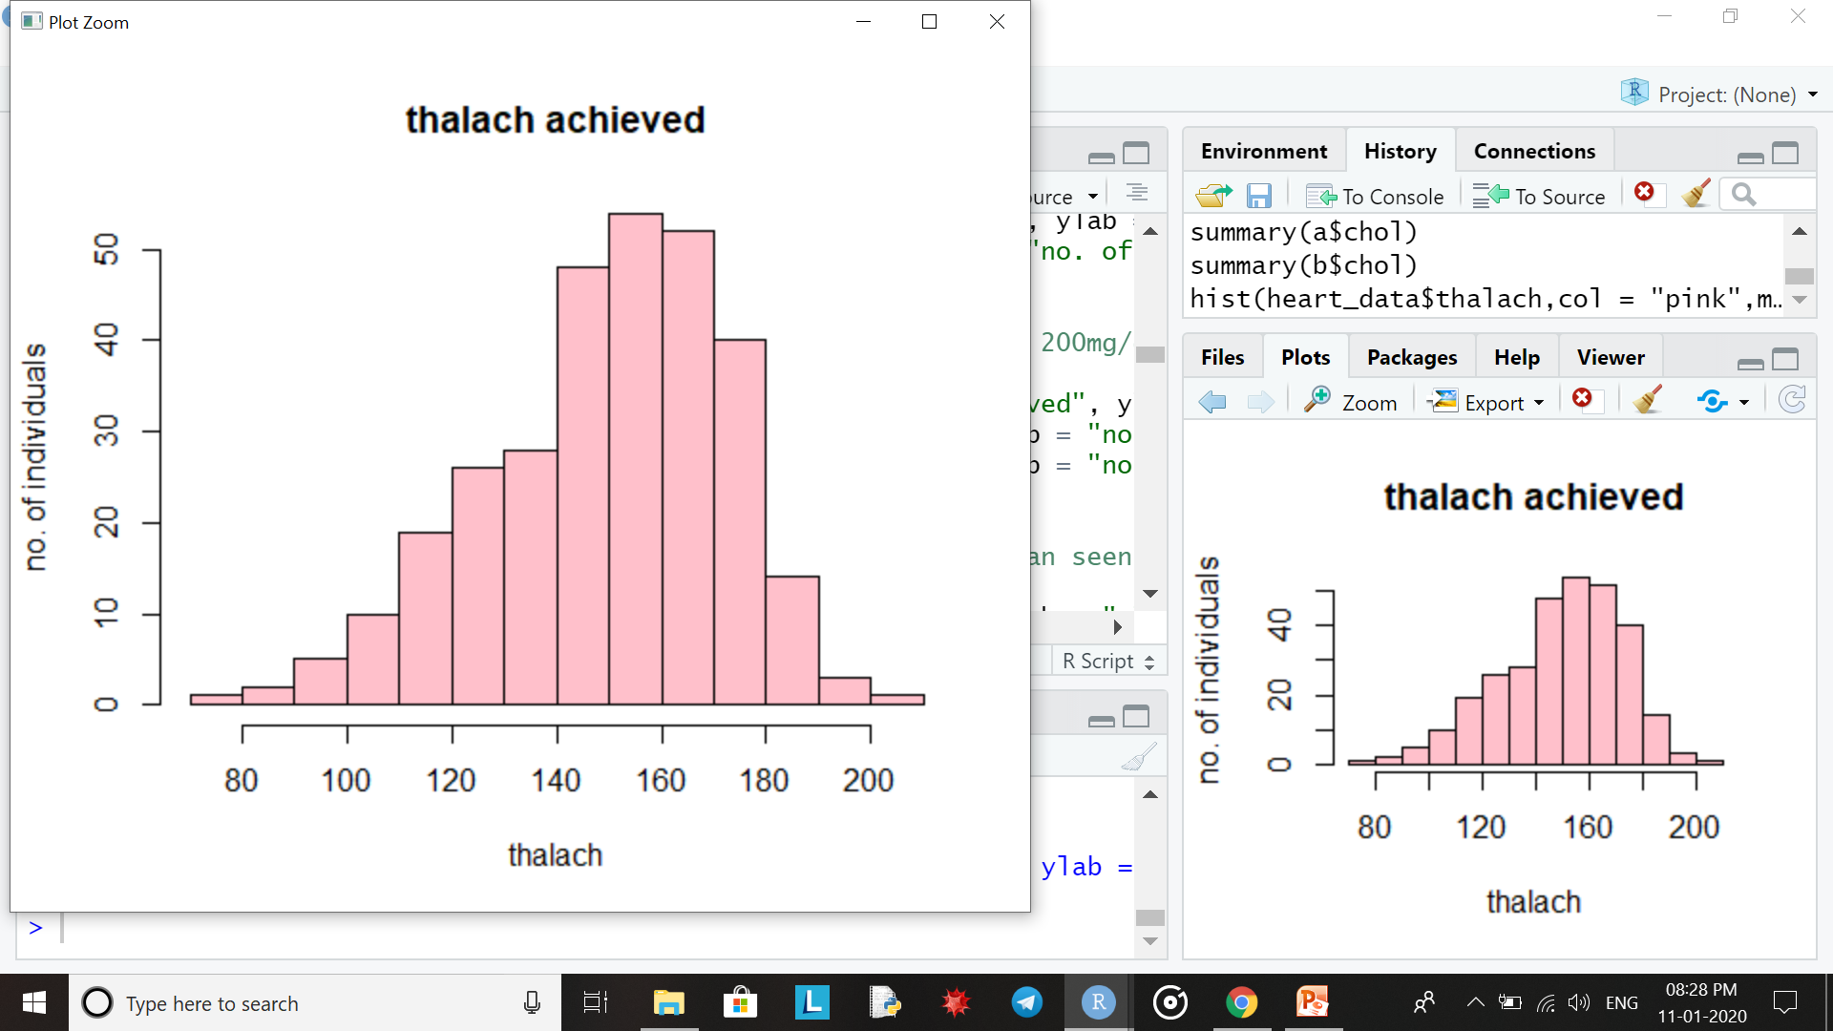
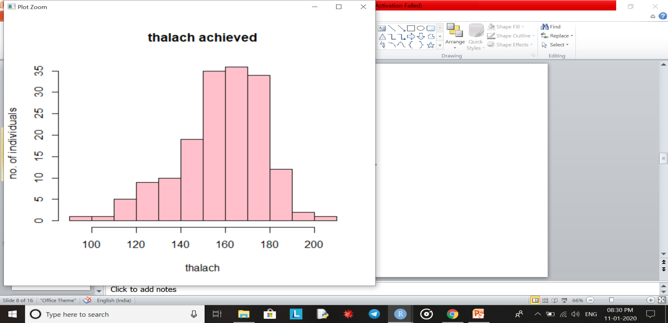
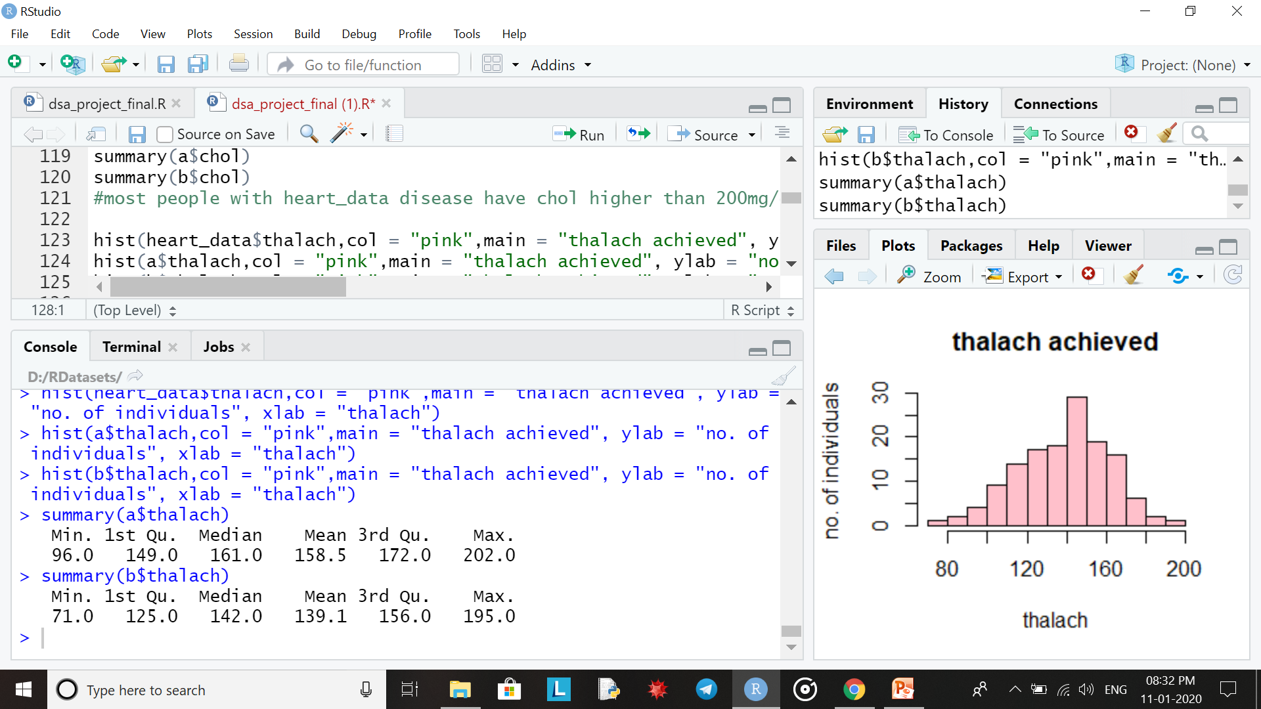
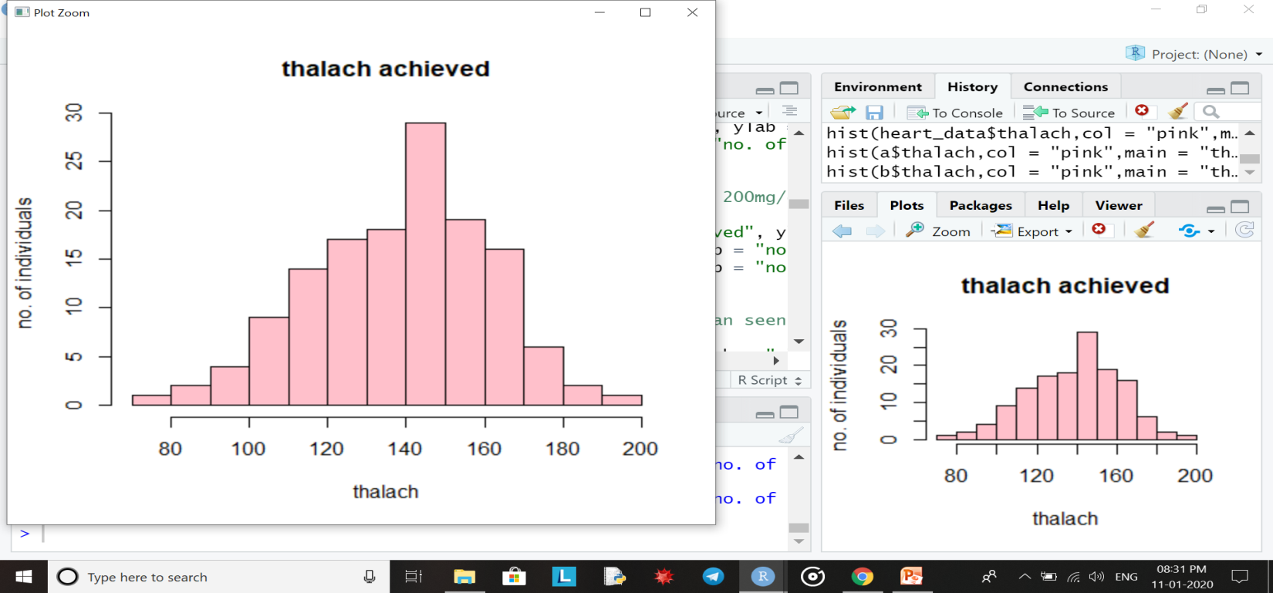
Entire data set
For individuals with heart disease
For individuals without heart disease
maximum heart rate of diseased patients is higher than seen in a healthy person
Thalach <- max. heart rate achieved

Slide 18
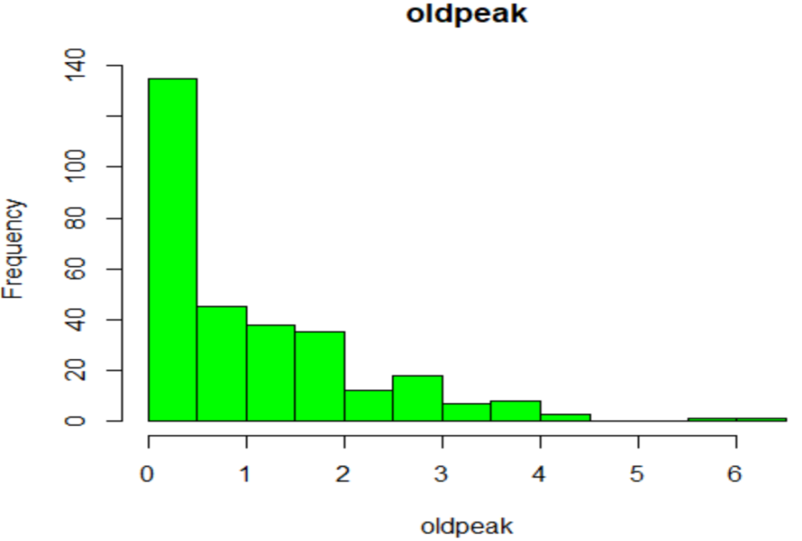
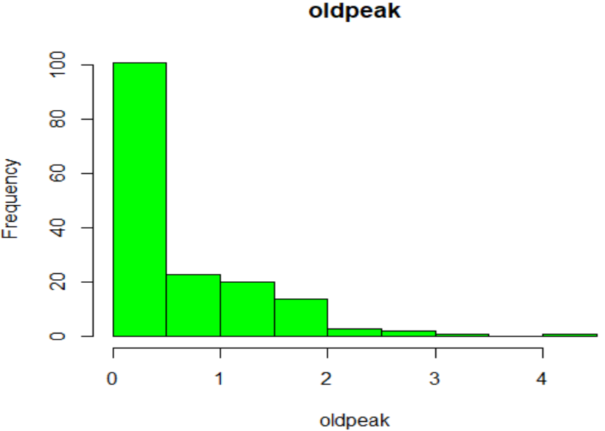
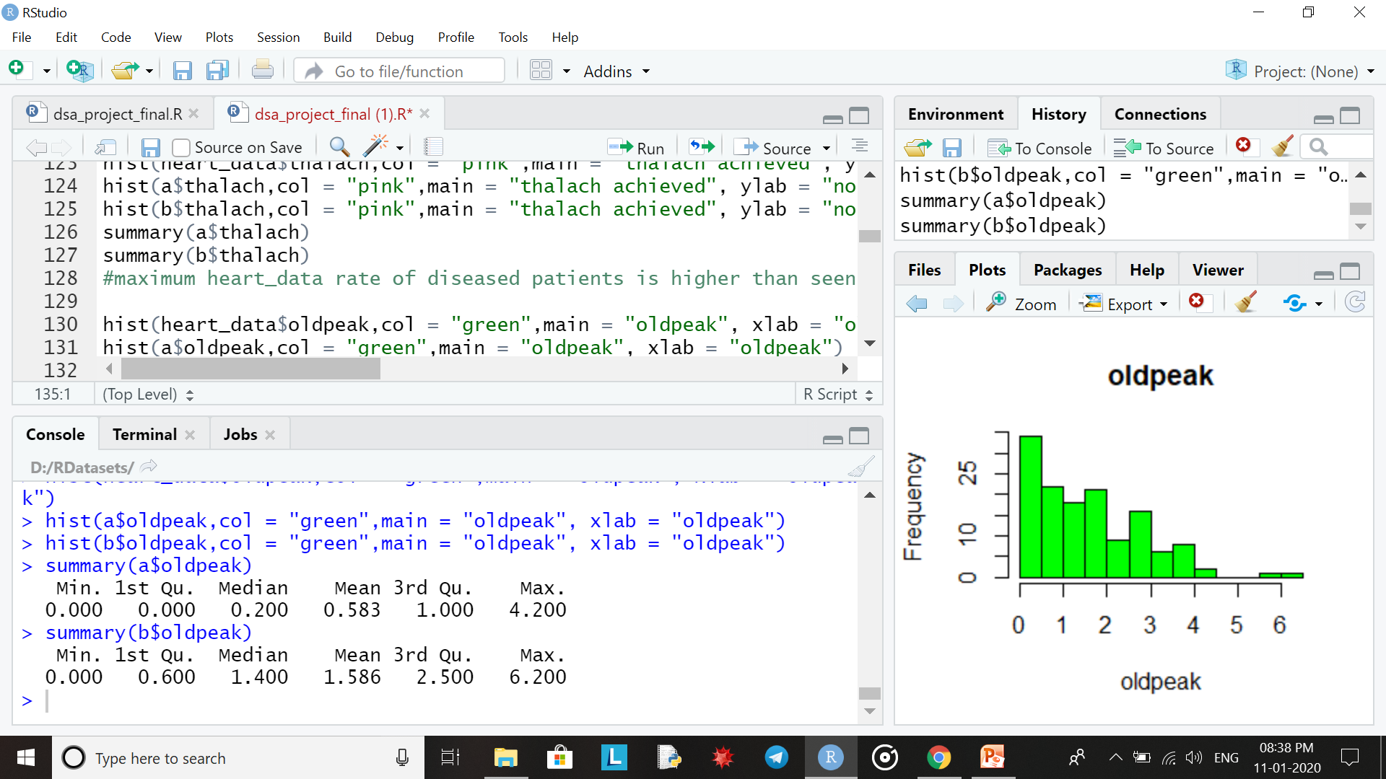
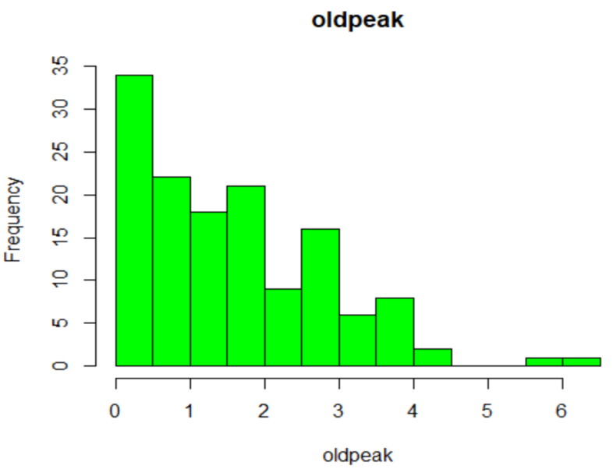
Entire data set
For individuals with heart disease
For individuals without heart disease
St_depression induced by exercise for diseased and non-diseased patients can be seen from these graphs

Slide 19
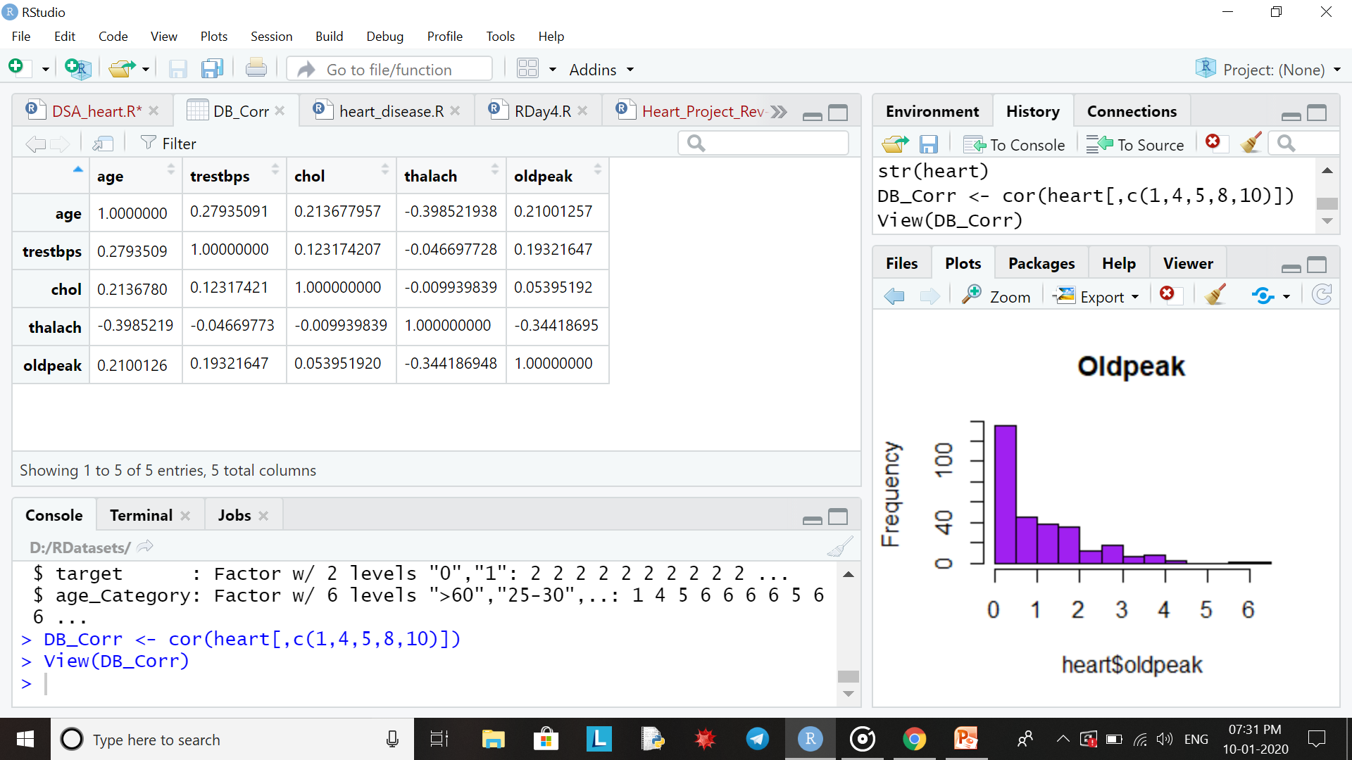
CHECKING FOR CORRELATION
What is correlation?
The existence of a relationship between two or more variables or factors where dependence between them occurs in a way that cannot be attributed to chance alone.
In R, methods to check for correlation:
1.Plot function
2.Pearson correlation coefficient for correlation between numeric variables.
3.Spearman correlation coefficcient for correlation between factor variables.
We have checked for correlation between the following variables using cor() function:
+ve sign shows positively related (i.e positive relation) ,
-ve related shows negatively related (i.e negative relation)

Slide 20
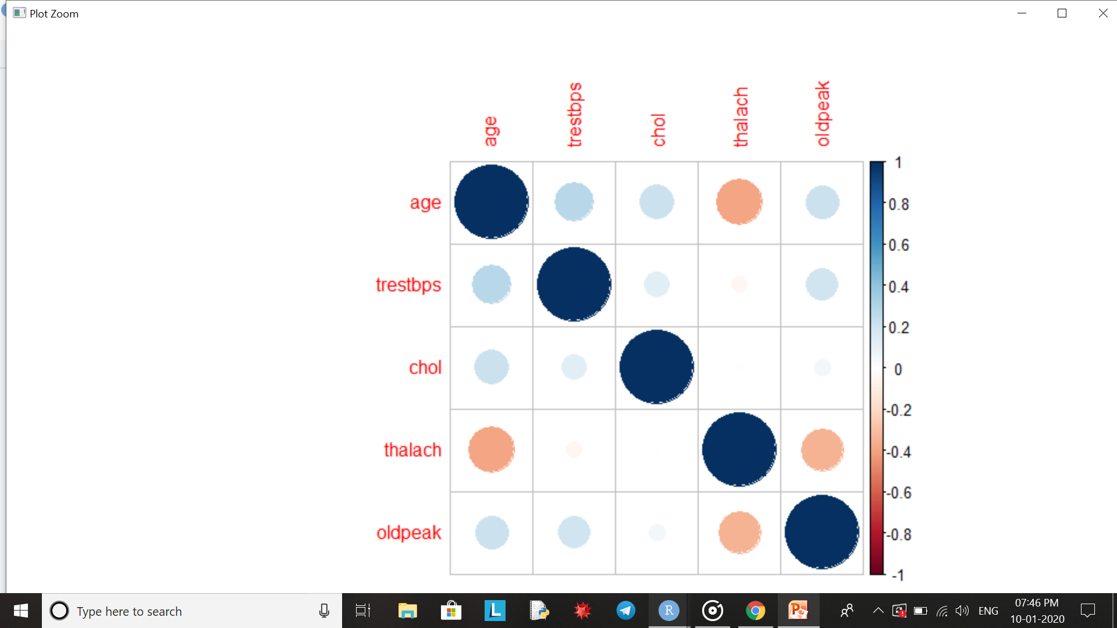
r is the coefficient of correlation which always lies between -1 and 1
r = 1 | Perfect positive correlation
r = -1 | Perfect negative correlation
r > 0.75 | Strong positive correlation
r < -0.75 | Strong negative correlation
r > 0.5 | Normal positive correlation
r < -0.5 | Normal negative correlation
Next, we install the ‘corrplot’ package to obtain the visual representation of correlation.
Positive correlations are displayed in blue and negative correlations in orange color.
Color intensity and the size of the circle are proportional to the correlation coefficients.
bigger size of circle shows higher correlation.

Slide 21
Using ggplot to find outliers
We install the package ggplot2.
ggplot2 is a system for creating graphics, based on The Grammar of Graphics. We provide the data, tell ggplot2 how to map variables to aesthetics, what graphical primitives to use, and it takes care of the details.
We have created boxplots for the attributes age, oldpeak, thalach, trestbps and chol with respect to age_Category to find any outliers in their data columns which might lead to incorrect results.
We assume that values in a dataset are clustered around some central value. Any value that lies more than one and a half times the length of the box from either end of the box is an outlier. If a data point is below Q₁ – 1.5×IQR or above Q₃ + 1.5×IQR, it is an outlier.
Outlier treatment by either removing them if they are not many in number otherwise imputed with the mode or median.

Slide 22
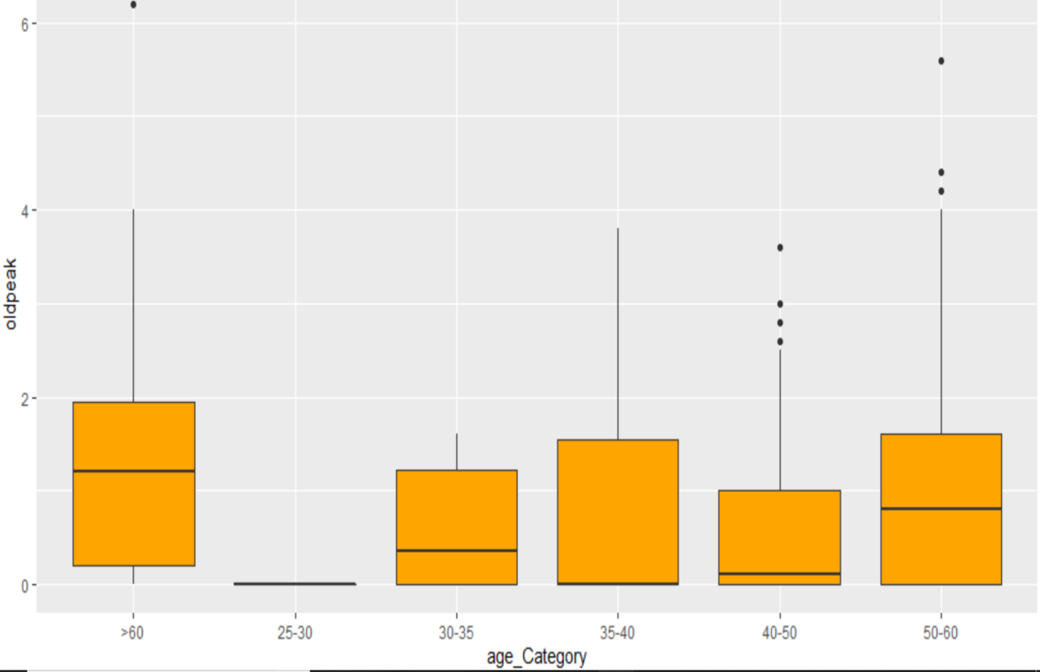
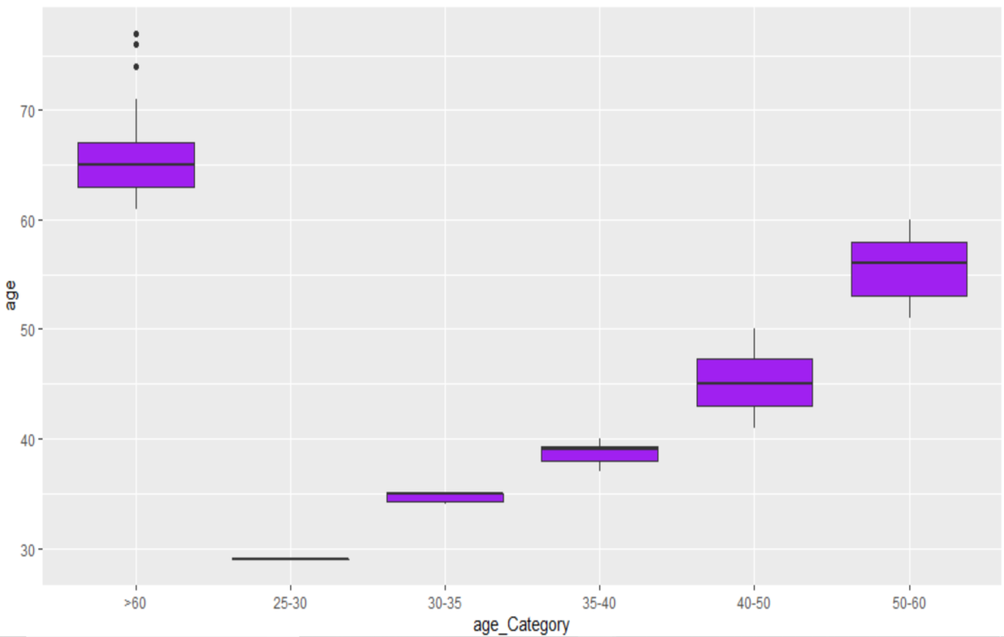
For oldpeak, there are a few outliers in the 40-50 and 50-60 range.
For age, there are a few outliers in the >60 range

Slide 23
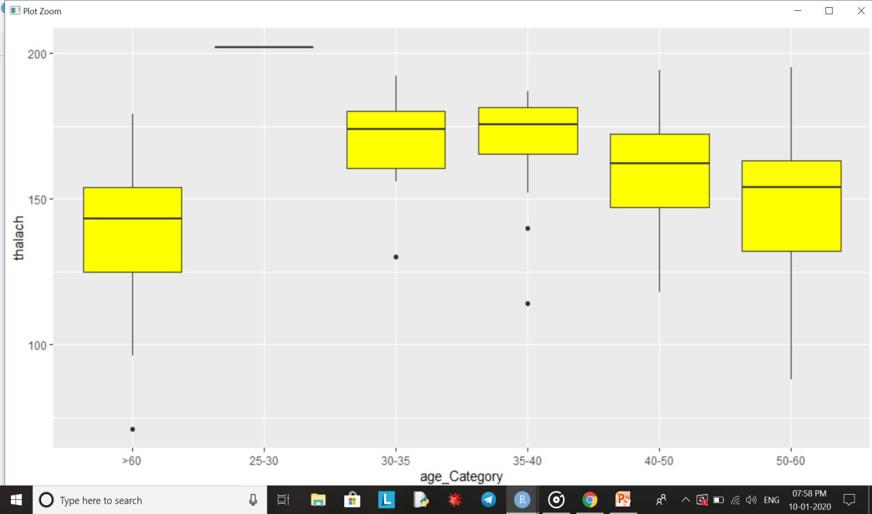
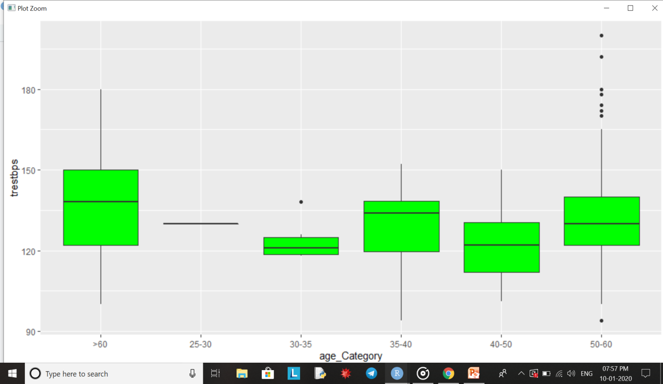
For thalach, there are some outliers in the range >60, 30-35 and 35-40
For trestbps, there are some outliers in the range 30-35 and 50-60

Slide 24
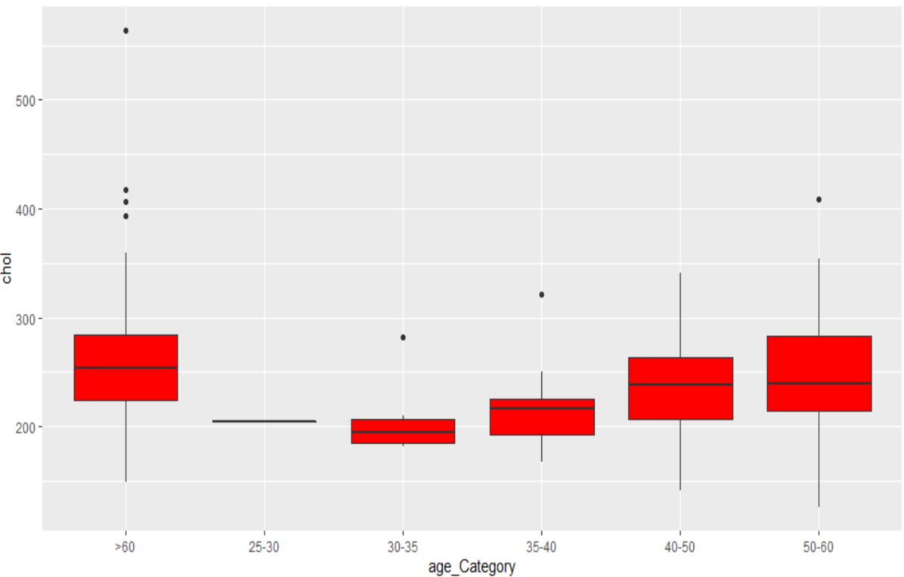
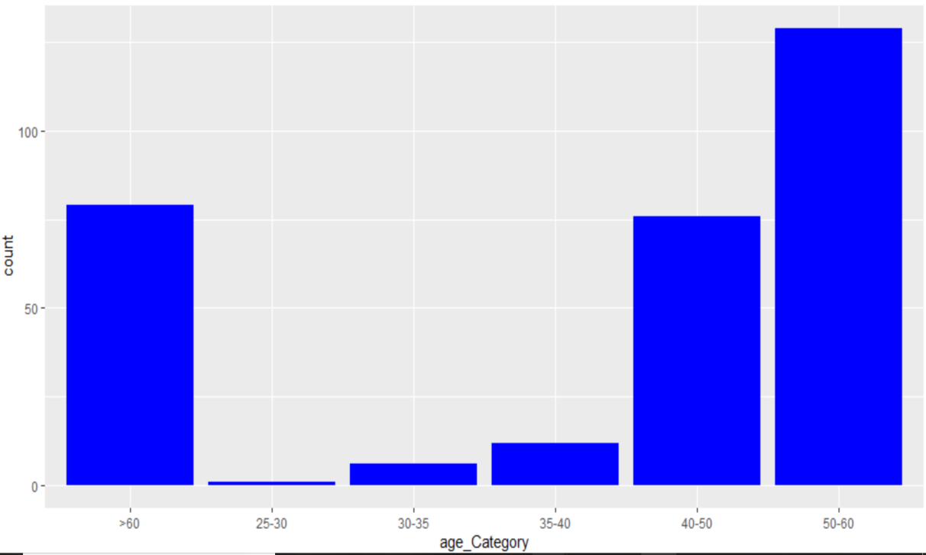
For chol, there are some outliers in the >60, 30-35, 35-40 and 50-60 range
In this histogram, people in the age category 50-60 have the maximum count whereas the least is in the 25-30 group

Slide 25
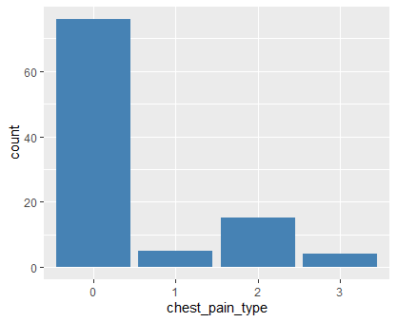
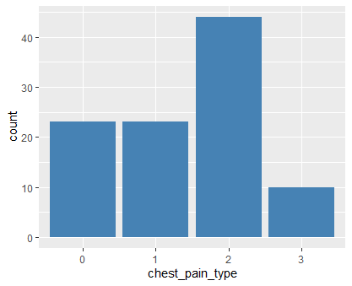
Chest Pain Type
Heart Disease and Chest Pain
No Disease and Chest Pain
0 -> typical angina
1 -> atypical angina
2 -> non angina
3 -> asymptomatic
Most of the people with heart disease show typical angina.
Most healthy people show non angina (chest pain not related to heart disease).

Slide 26
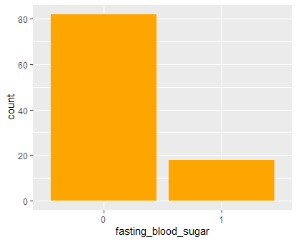
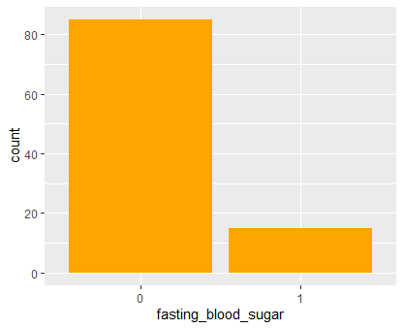
Fasting Blood Sugar
Blood Sugar and Heart Disease
Blood Sugar dist. for non-diseased
Fbs > 120mg/dL:
0 -> false
1 -> true
A slightly larger proportion of diseased patients show higher levels of blood sugar. Most individuals do not have fasting blood sugar levels > 120mg/dL.

Slide 27
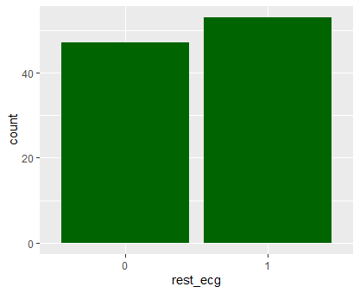
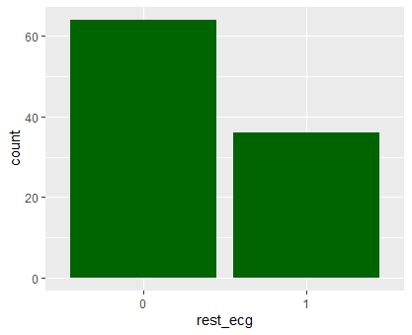
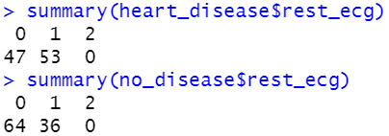
Resting ecg
Resting ecg and Heart Disease
Resting ecg for Non-diseased
0 -> normal
1 -> ST-T wave abnormality
2 -> left ventricular hyperthropy
A very large proportion of individuals with heart disease report ST-T wave abnormality in their ecg. Very few individuals reported hyperthropy.

Slide 28
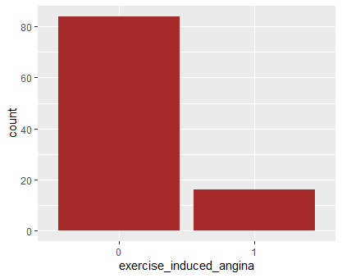
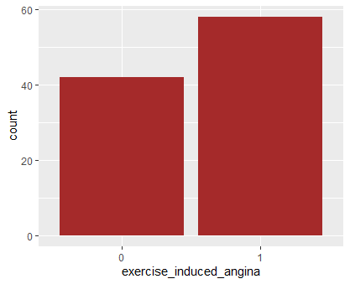
Exercise induced angina
For diseased subset:-
For non-diseased subset:-
0 -> no
1 -> yes
More number of individuals without heart disease experienced exercise induced angina.

Slide 29
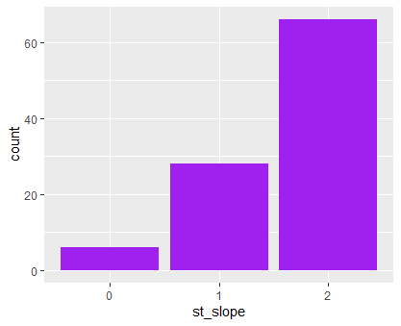
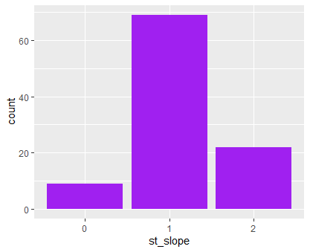
Slope of peak exercise ST segment
For diseased subset:-
For non-diseased subset:-
0 -> downsloping
1 -> flat
2 -> upsloping
ST depression induced by exercise relative to rest is observed more in individuals with heart disease while a large proportion of non diseased people show flat or normal st slope.

Slide 30
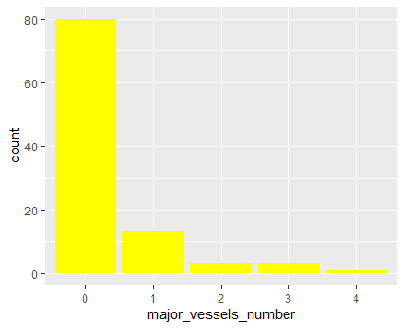
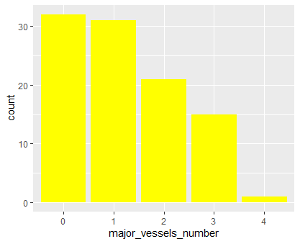
No. of major arteries coloured by fluoroscopy
For diseased subset:-
For non-diseased subset:-
Individuals with heart disease have one or more major arteries blocked (hence not colored by fluoroscopy).

Slide 31
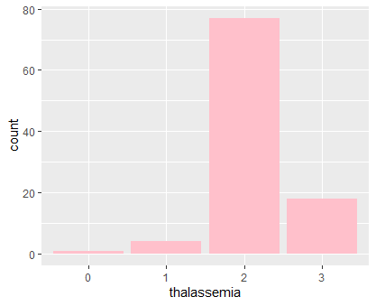
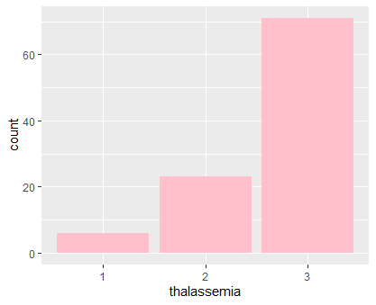
Thalassemia
For diseased subset:-
For non-diseased subset:-
1 -> normal
2 -> fixed defect
3 -> reversible defect
Most number of individuals with heart disease have fixed defect of thalassemia.

Slide 32
Division of data into test and train
The entire dataset is randomly divided into two parts- train and test
Train: This part of the dataset is used for model building. Analysis is done for this dataset and an appropriate model is built according to requirements.
Test: This part of the dataset is used to test the model on. After getting the output via the model on this data, it can be compared to the original output and the accuracy of the original model can be predicted

Slide 33
Tools Used for Division
caret library is used for division of data.
createDataPartition() function is used to divide the data.
The dependent variable , i.e., ‘target’ is used as the basis of the division in order to avoid any biasness.
60% of data is taken for the train dataset and the rest 40% of data is taken for the test dataset.

Slide 34
Logistic Regression
Logistic Regression is a statistical model used for binary classification, that is prediction of the type this or that, yes or no, A or B, etc.
For binary data, the goal is to model the probability p that one of two outcomes occurs.
ln[p/(1-p)] = b₀ + b₁X₁ + b₂X₂ + … + b_{k}X_{k}
In Logistic Regression, we use maximum likelihood method to determine the best coefficients and eventually a good model fit.

Slide 35
Modeling:
Why this approach?
We have used Logistic Regression because the dependent variable (whether a person suffers from heart disease or not) is categorical, that is it has values:
0- person does not suffers from heart disease
OR
1- person suffers from heart disease

Slide 36
Selection of Important variables for the model
For better accuracy it is required that the variables do not have perfect correlation among themselves. Hence we check if multicollinearity exists, that is, we find the Variance Inflation Factor (VIF) for the variables in the data. If the VIF for a variable is greater than 5, it indicates a problematic amount of collinearity.
In the dataset, the VIF for ‘age’ is very high, hence it should not be included in the model.

Slide 37
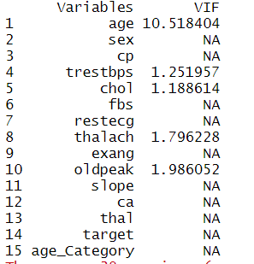
VIF of the variables of the dataset

Slide 38
Testing the significance of regressors
We build a model by regressing ‘target’ with all other variables. Thereafter, we check the summary of the model built.
Null Hypothesis (h0): The explanatory variable does not affect the dependent variable.
Alternative Hypothesis (hA): The explanatory variable affects the dependent variable.
If p>0.05 (level of significance), h0 is accepted, else it is rejected.

Slide 39
p-values for ‘sex’, ‘cp’, ‘ca’, are less than 0.05, hence they must be included in the model.
p-value for ‘thalach’ is slightly higher than 0.05
p-values for all other variables are much higher than 0.05, hence they must not be included in the model
Based on this, we first build model A by regressing ‘target’ with ‘sex’, ‘cp’, ‘ca’, and ‘thalach’
We build another model B by regressing ‘target’ with ‘sex’, ‘cp’, ‘ca’, and by dropping ‘thalach’ to see the impact.

Slide 40
Model Selection
We use Stepwise Elimination to select the important variables:
Step 1: We build a model with x1 variable only.
Step 2: We include x2 in the model and see if it is significant (R-square goes up & AIC goes down). If yes, we keep the new model.
Step 3: After inclusion of the second variable see if the existing variable can be dropped in the presence of new variable. Exclude x1 from the model and see if it were insignificant (R-square goes down & AIC goes up). If yes, we keep the new model.
Step 4 : Repeat the same for all the remaining variables while keeping the latest model.

Slide 41
Stepwise Elimination gives us the following important variables:
slope
thal
oldpeak
cp
ca
sex
Hence we build model C with these variables.

Slide 42
Accuracy Check
Using Predicted == Actuals
This involves comparison of true(actual) values and predicted values. According to this:-
Accuracy for Model A = 0.793388429
Accuracy for Model B = 0.785123966
Accuracy for Model C = 0.851239669
Accuracy of Model C is highest (85.12%), making it the best fit model.

Slide 43
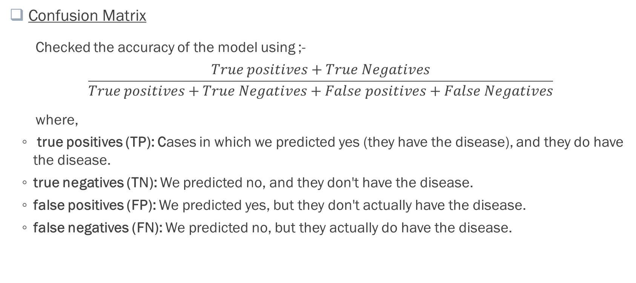
Confusion Matrix
Checked the accuracy of the model using ;-
$$\frac{True positives+True Negatives}{True positives+True Negatives+False positives+False Negatives}$$
where,
true positives (TP): Cases in which we predicted yes (they have the disease), and they do have the disease.
true negatives (TN): We predicted no, and they don't have the disease.
false positives (FP): We predicted yes, but they don't actually have the disease.
false negatives (FN): We predicted no, but they actually do have the disease.

Slide 44

According to the confusion matrix, the accuracy of the model is (add from final code):-
For model A = ((44+52) / (44+52+11+14))
= 0.79338
For model B = ((42+53) / (42+53+13+13))
= 0.78512
For model C = ((48+55) / (48+55+11+7))
= 0.85123
Model C has highest accuracy (85.1%). Model C is the best fit model.

Slide 45
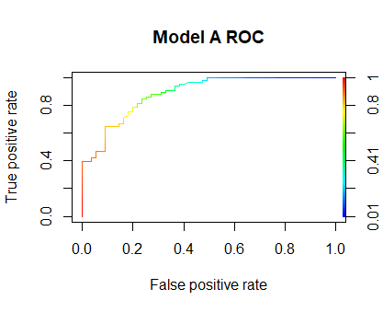
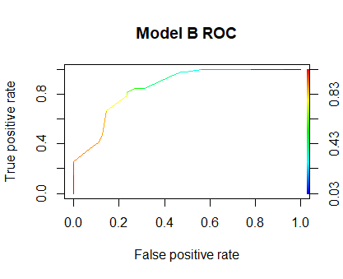
Receiver Operator Characteristic (ROC) Curve
The aim is to push the ROC Curve towards 1 (upper left corner). The higher the curve, the larger the area under the curve (auc), better the model. It suggests that the diseased and non diseased groups are well distinguished.
Auc = 0.8870523
Auc = 0.8586777

Slide 46
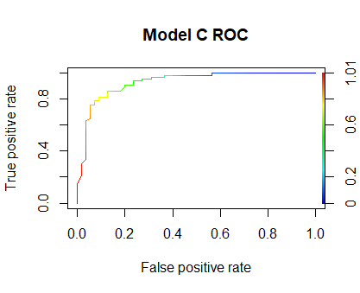
The auc obtained is 0.9299989, which means there is 92.9% chance that model will be able to distinguish between patients with disease and patients without disease.
Hence, Model C is the best fit model.

Slide 47
Conclusion
Exploration of the data indicated that an individual’s age, gender, chest pain type, cholesterol level, maximum heart rate, exercise induced angina, ST peak depression induced by exercise and slope of the peak exercise ST segment were possible useful features for predicting the presence of heart disease. ECG results and thallasemia diagnosis were also found to have a minor predictive power. Based on the results, some of the following measures can be taken:-
Male targeted heart health programs/schemes.
Manufacture of cholesterol reducing/ inhibiting products.
Anaemia awareness and management programs, medicine production.
Since typical angina is maximum observed in heart patients, production of nitroglycerol can be increased. Nitroglycerol is medicine for typical angina.

Slide 48
Alternative approach:-
Alternatively Random Forest can also be used for model making.
But, Random Forest being a ‘black box model’ , it is rather difficult to understand the underlying processes.
Hence, we prefer to use Logistic Regression for modeling.

Slide 49
Tools Used:-
We used R programming to analyse the given data.
We have installed and used the following packages:
bit64
caret
data.table
usdm
glm() function is used to build the Logistic Regression model.

